Slide 1
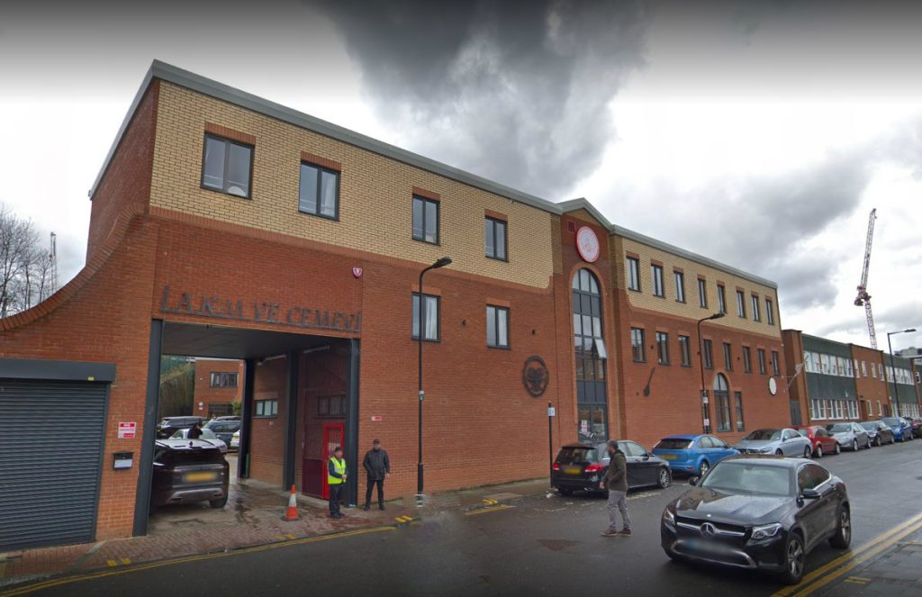
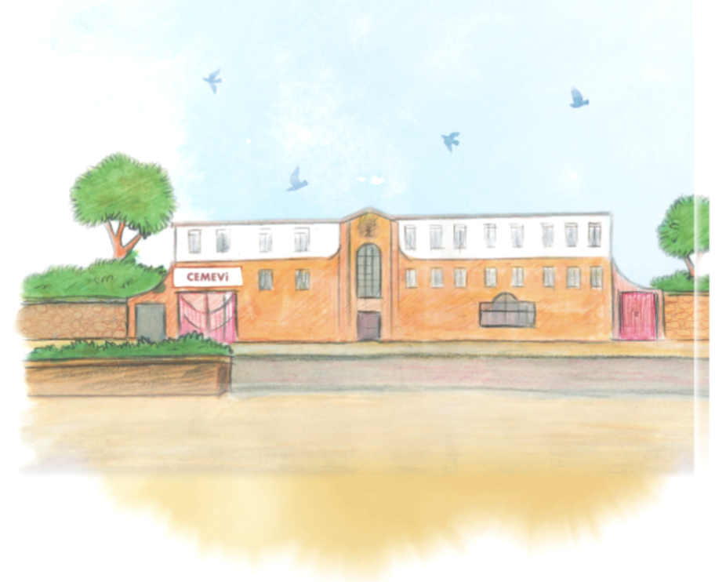
What happens when Alevis worship together?

Slide 2
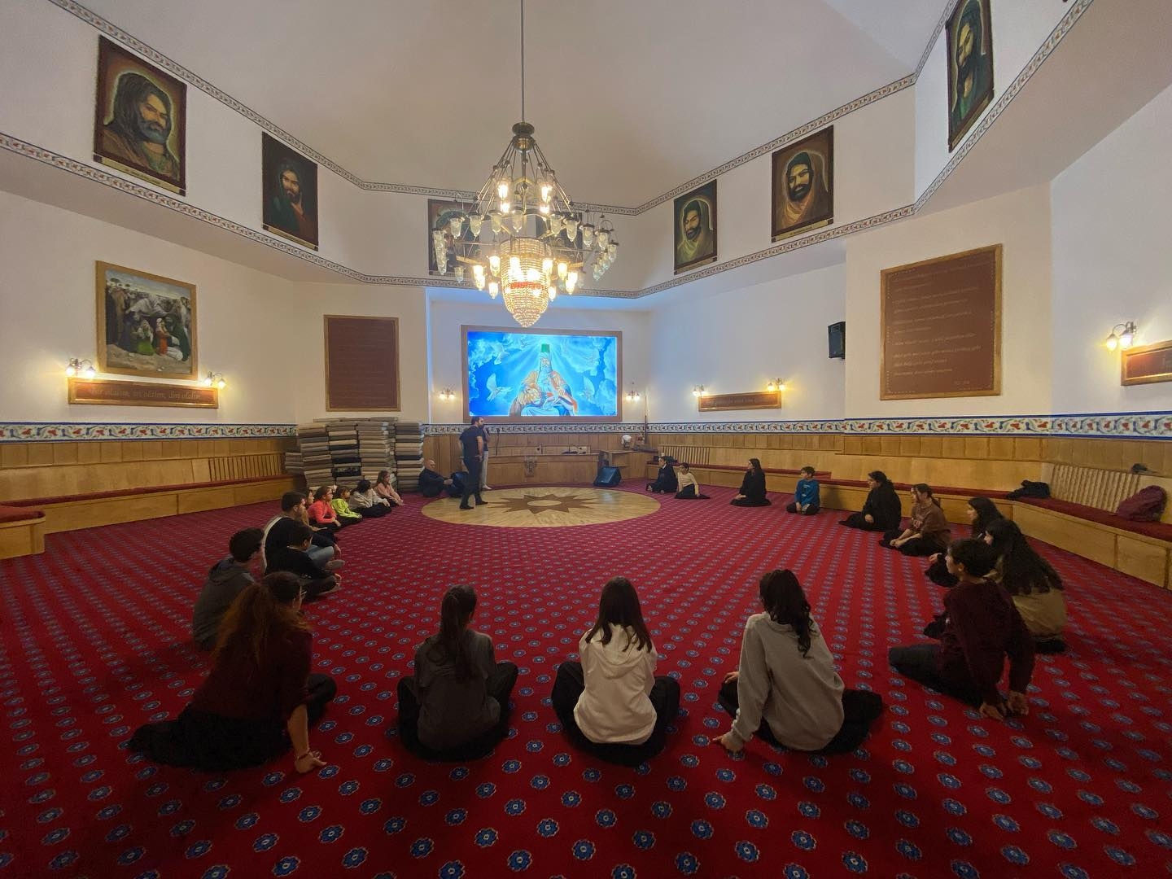
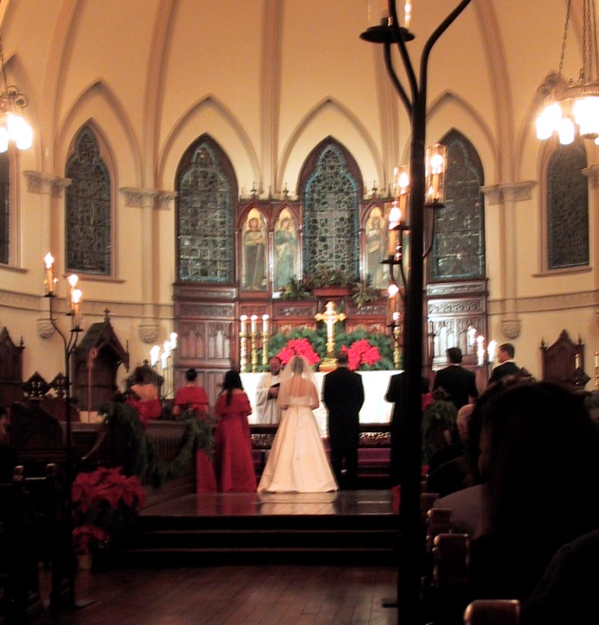
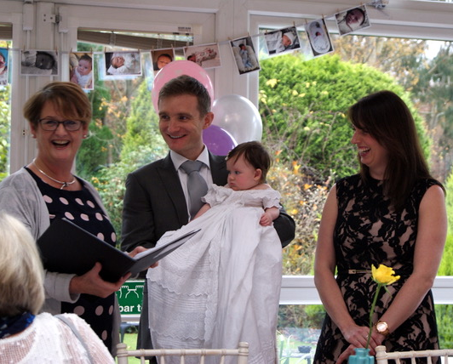
What is a ceremony?

Slide 3
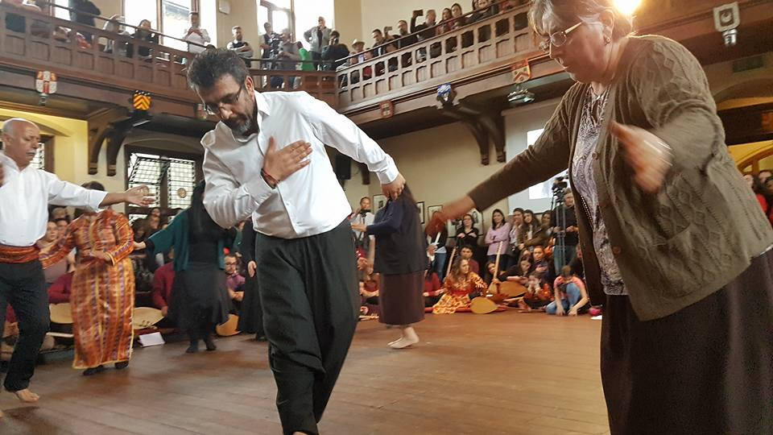
What happens in a cem ceremony?
The Alevi ceremony is called the cem (pronounced jem!)
As you watch the video
https://youtu.be/5DAVIgWlZD4
of a cem ceremony, use the sheet to tick the things that you see happen.

Slide 4
The cem ceremony

Slide 5
Draw a picture in each box of something that happens in a cem ceremony
Picture 1
Picture 2
Picture 3

