Slide 1
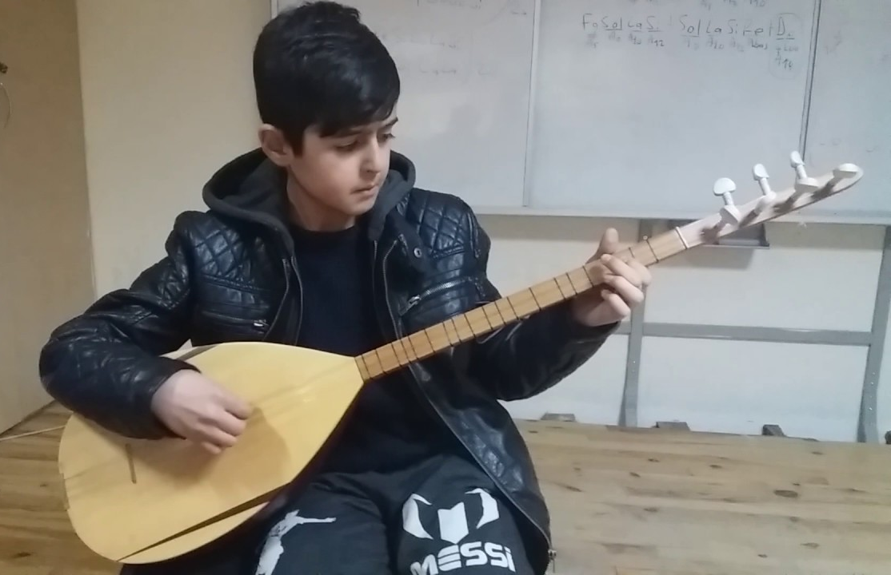
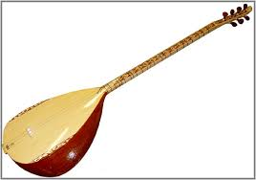
Why is music important to Alevis?

Slide 2
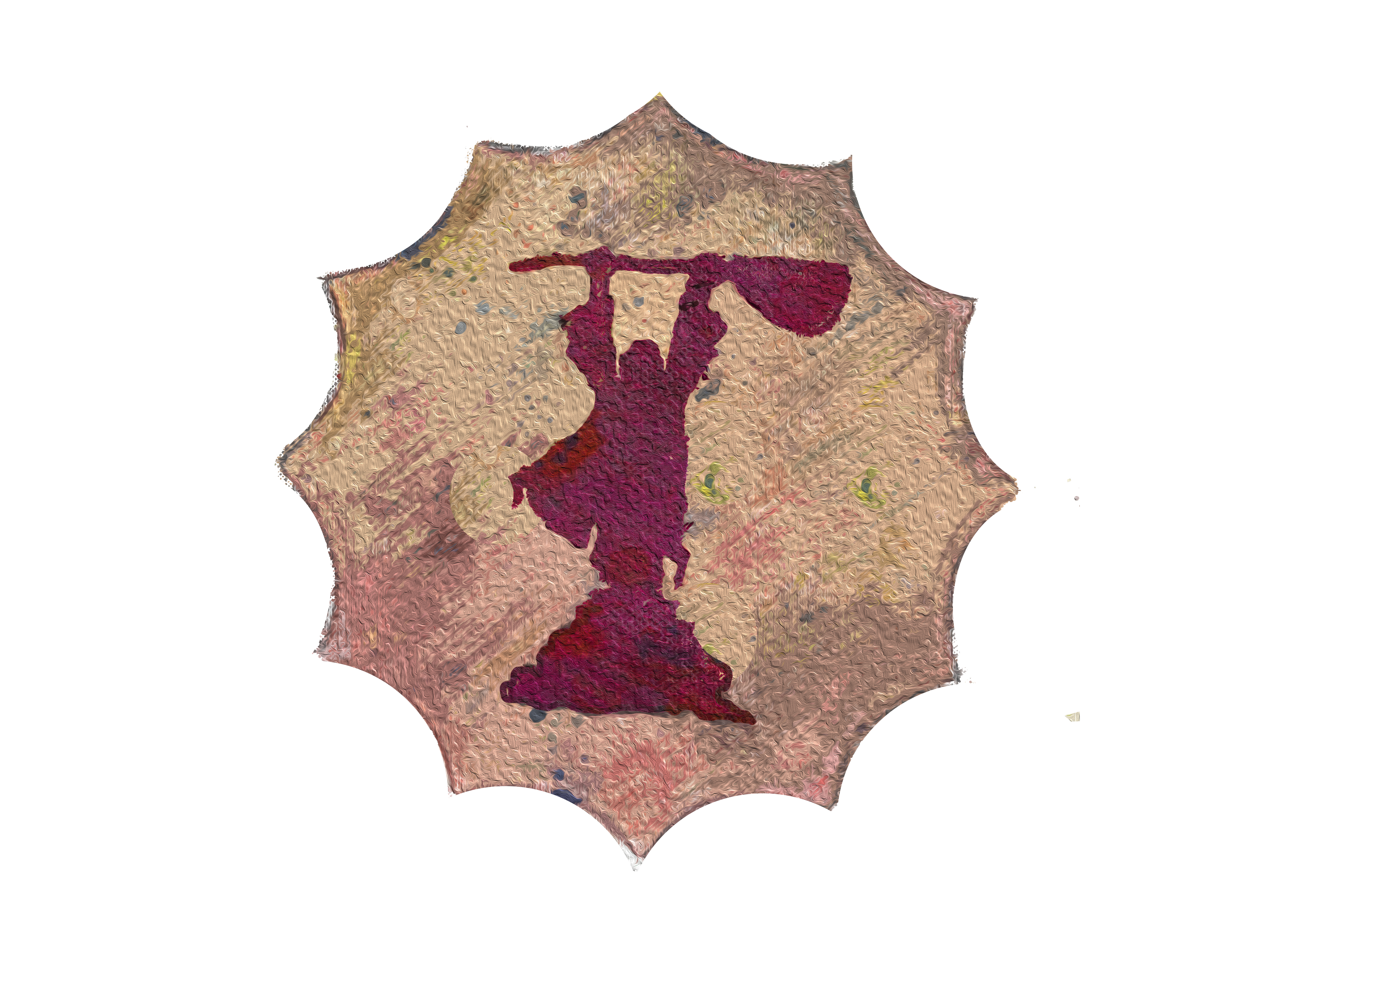
What do you see in this symbol?
This is an important Alevi symbol
What is the person holding?
What else do you notice?

Slide 3
The saz
Alevis love music.
The saz helps them feel and think about things and they express this through songs, poems and dance.
https://www.youtube.com/watch?v=bvyIF0fcJrw&t=10s
https://www.youtube.com/watch?v=9wPt9scySfk&t=2s

Slide 4
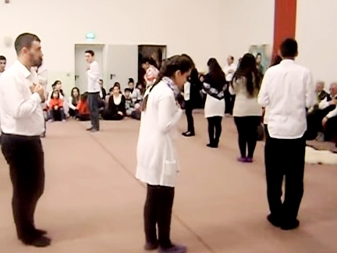
The semah is one of the most important parts of cem.
Those who are not dancing usually join in with singing.
Semah makes people feel close to each other and to Hak/God
https://www.youtube.com/watch?v=1TK6yvG0-4U

