Slide 1
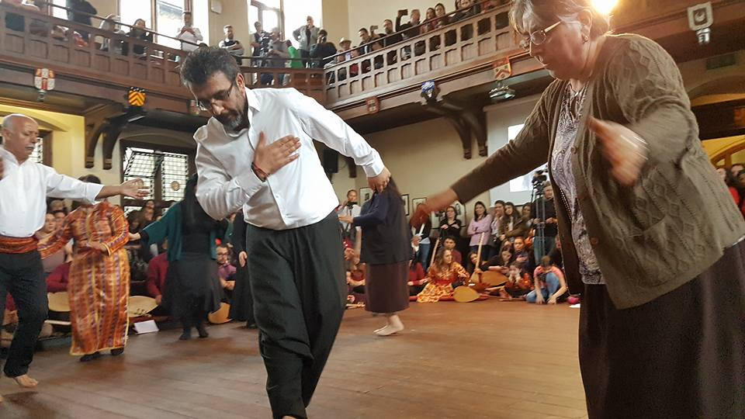
Who are the Servers and why are they important?

Slide 2
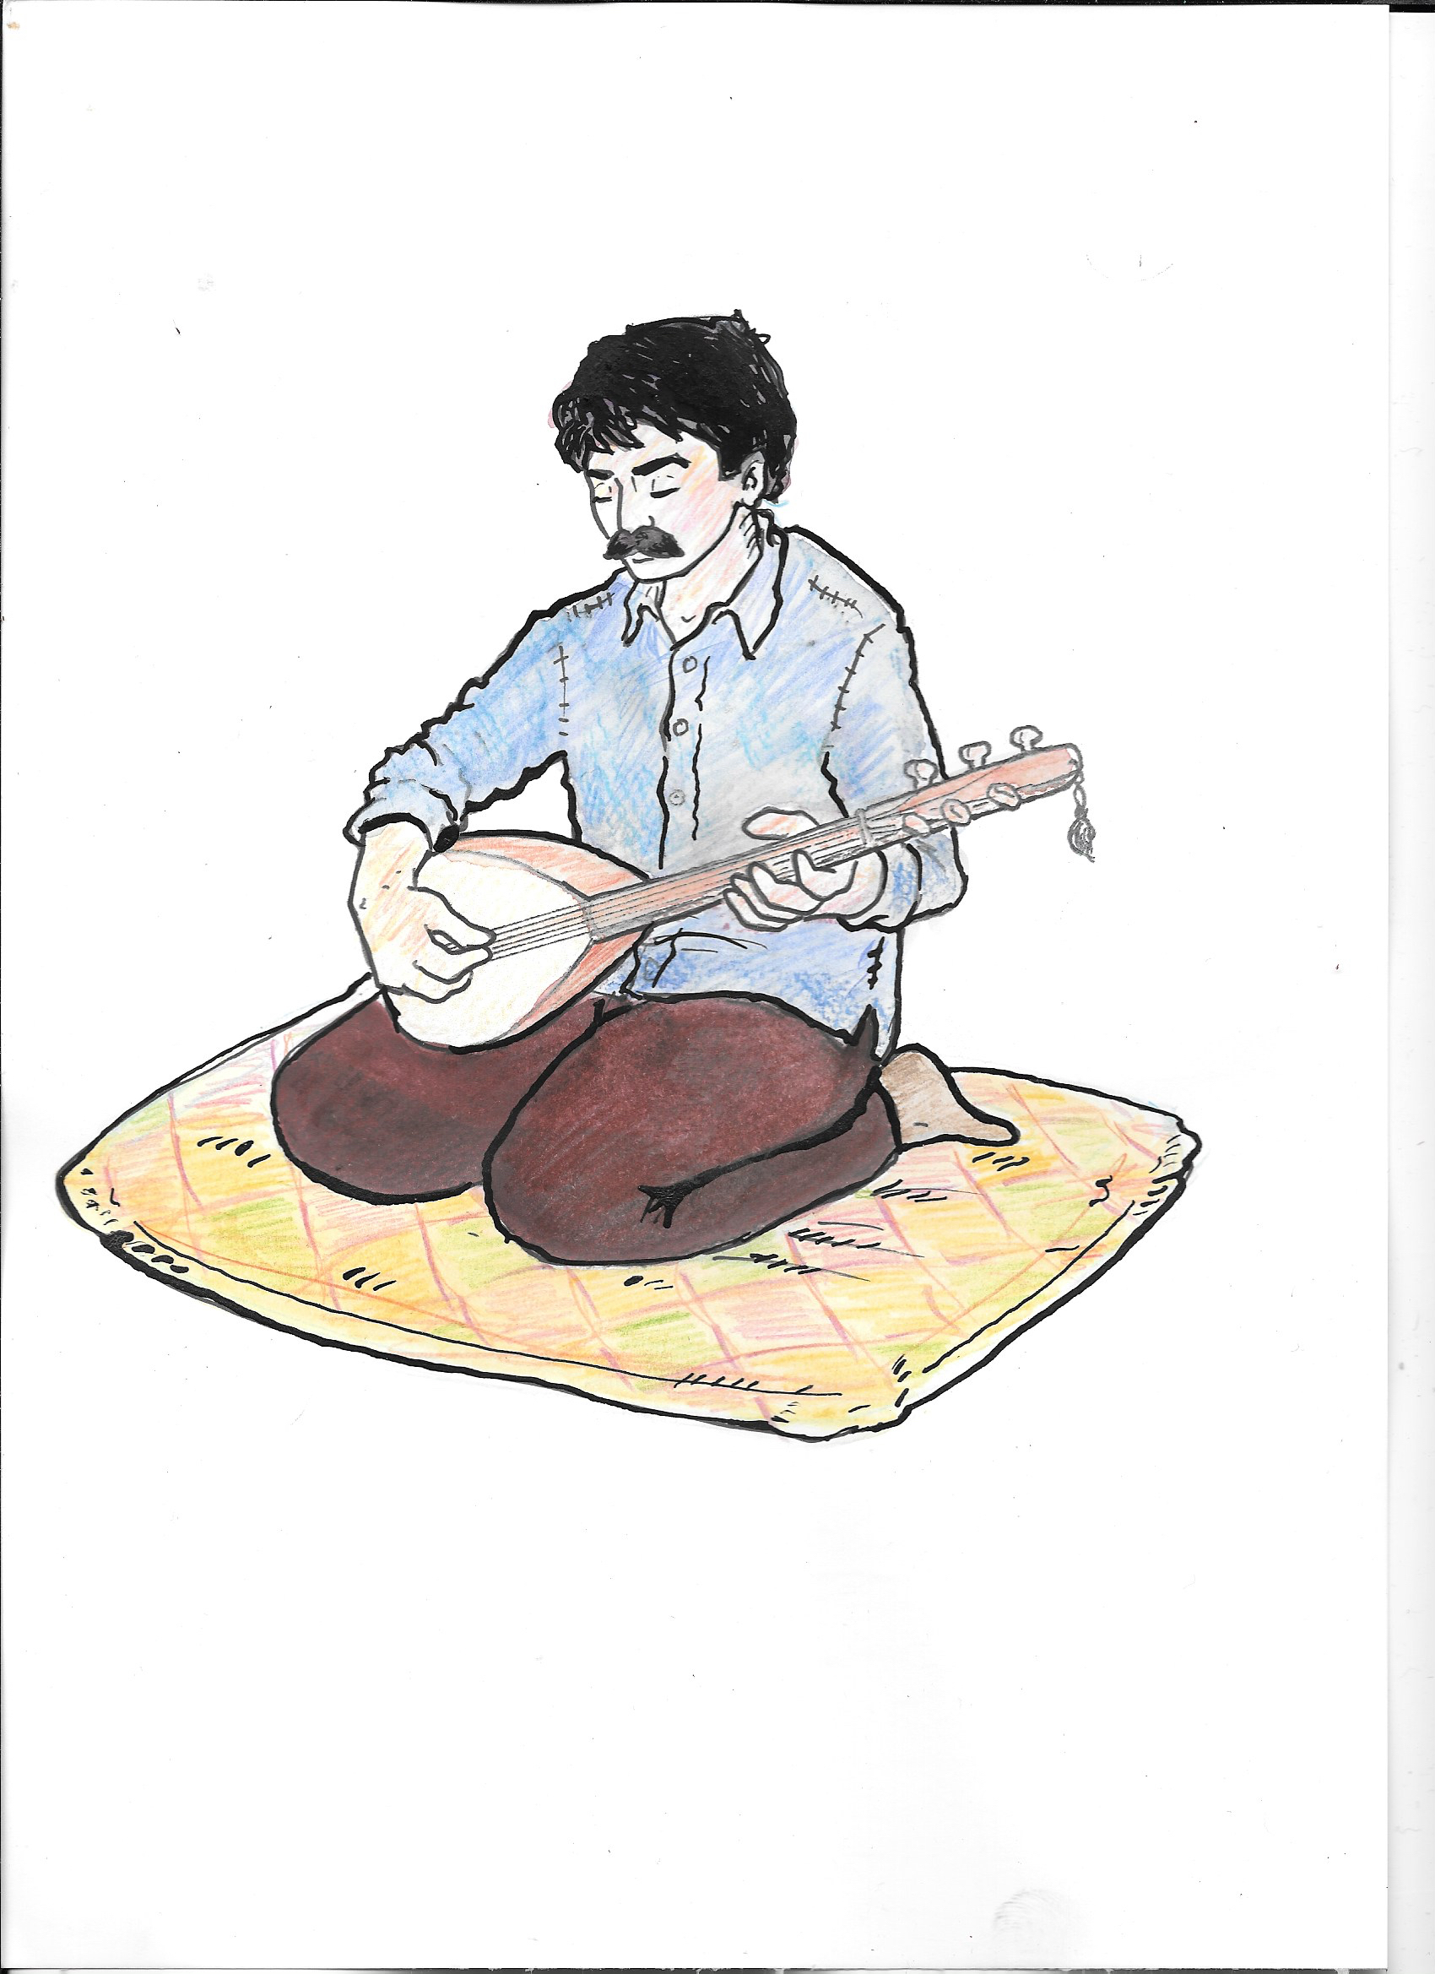
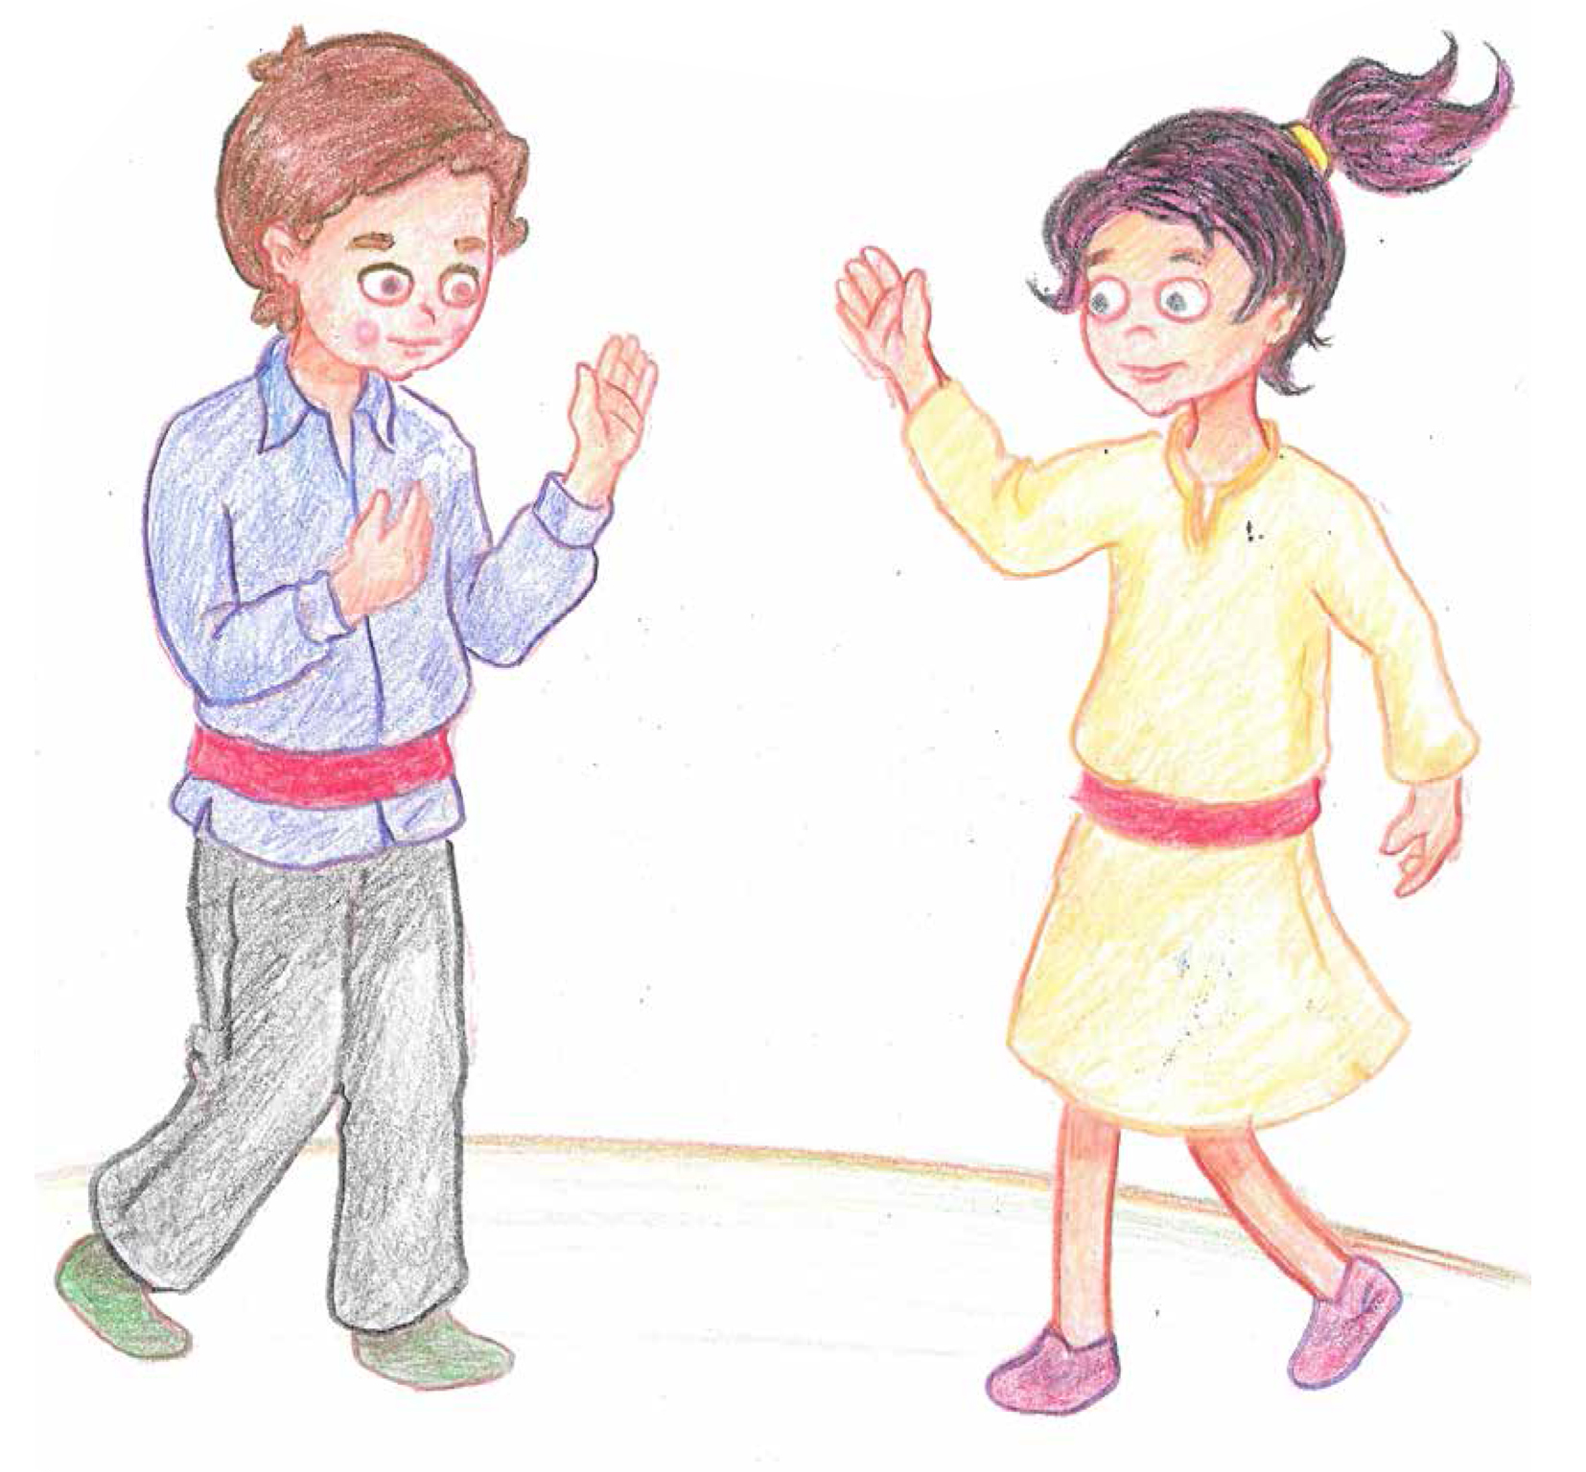

Slide 3
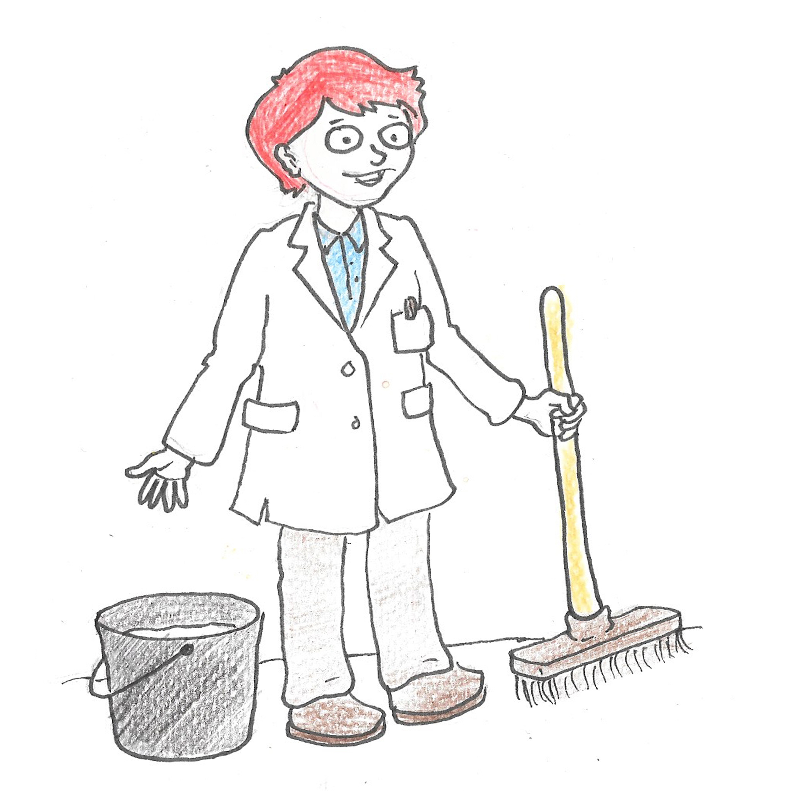
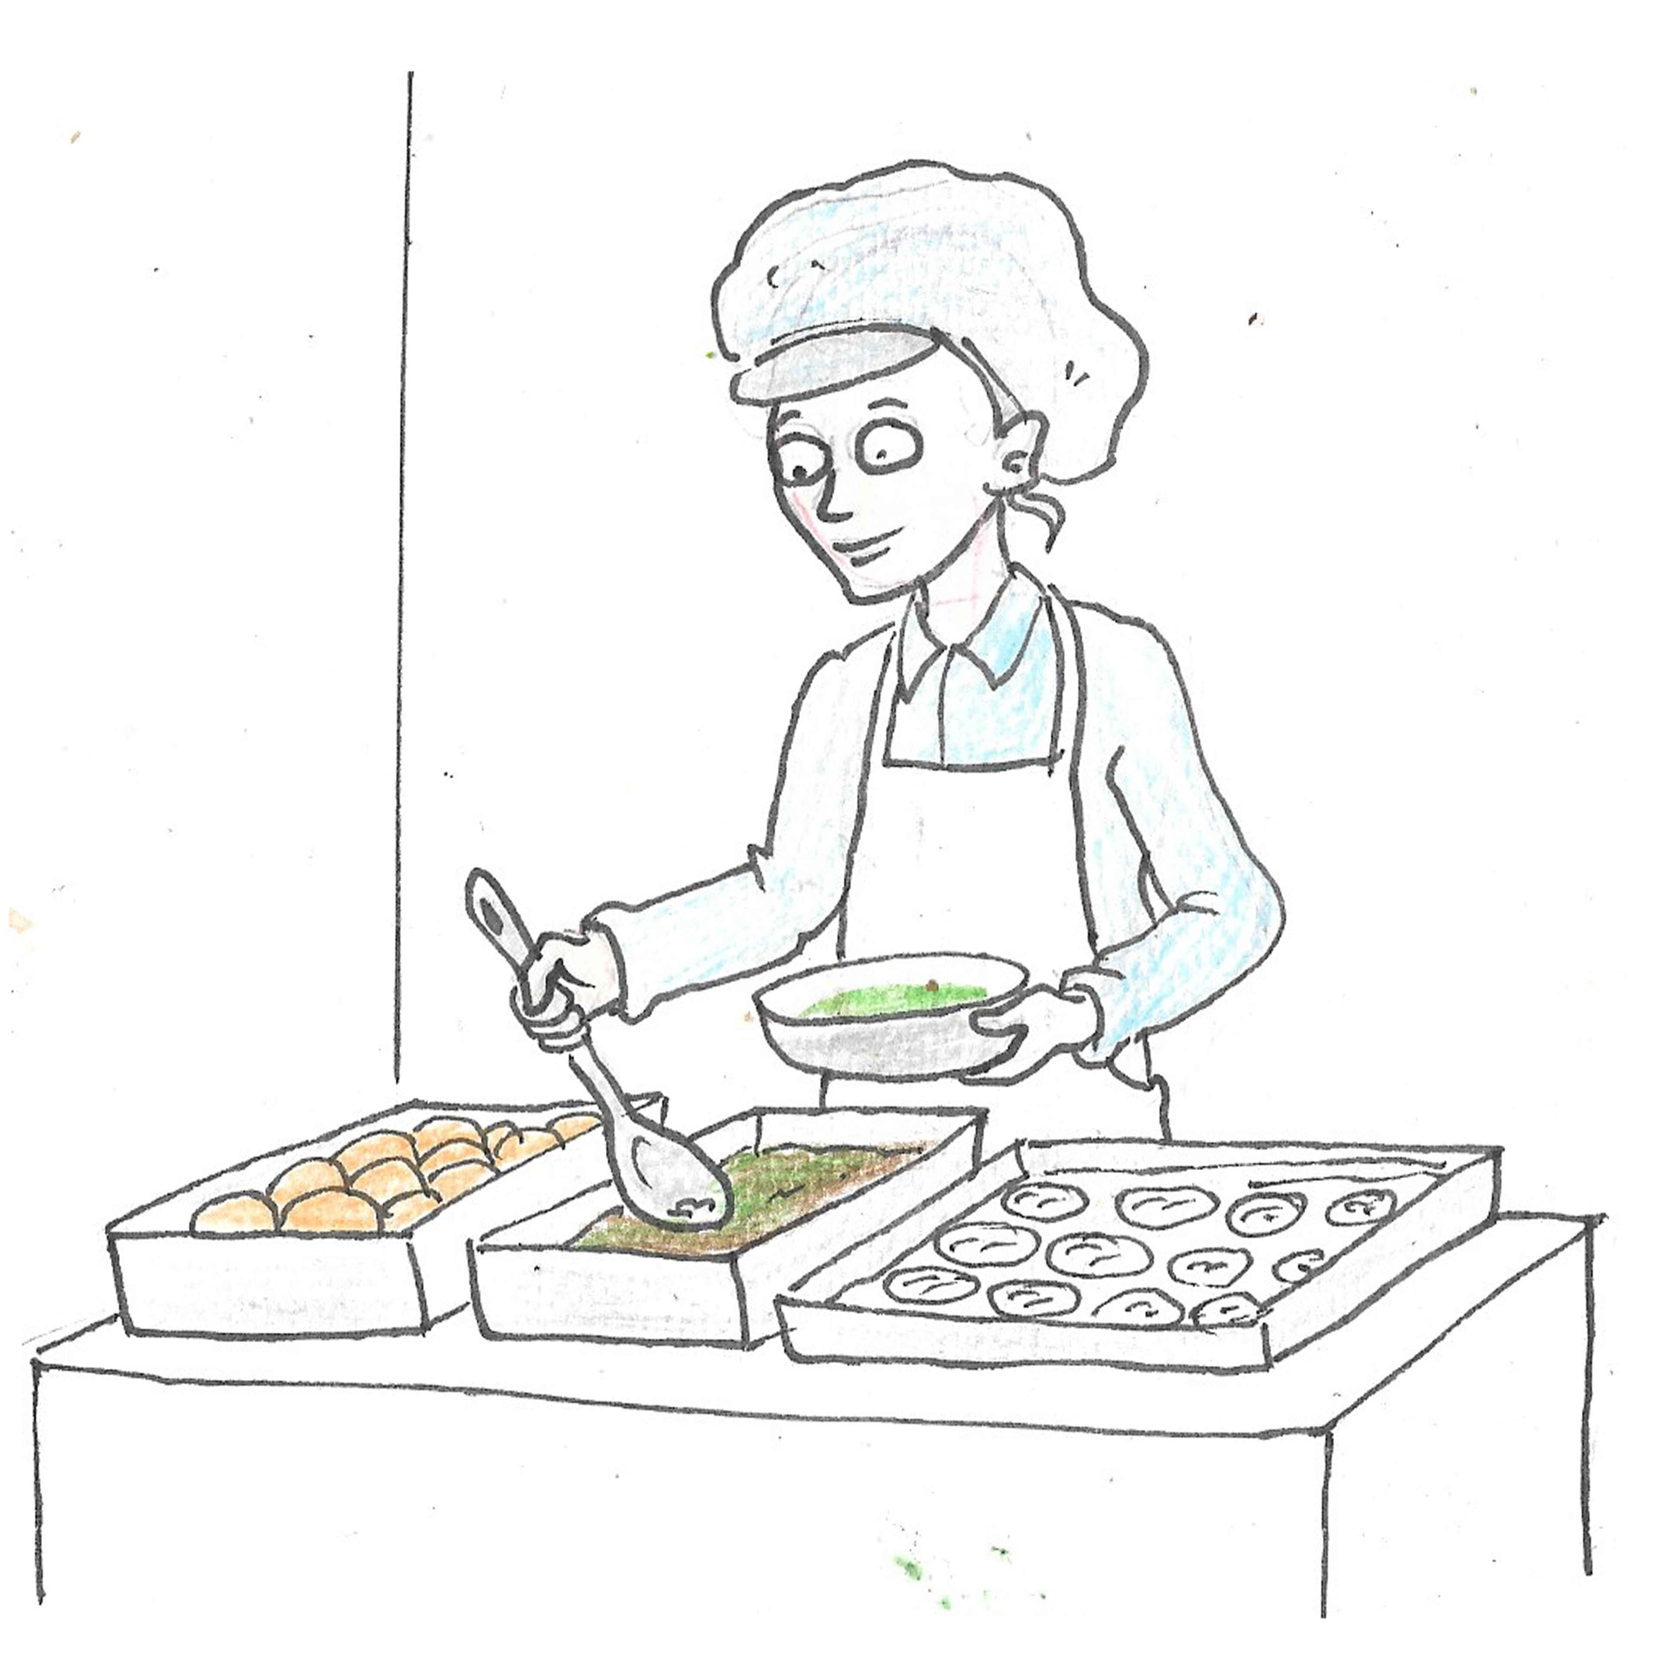
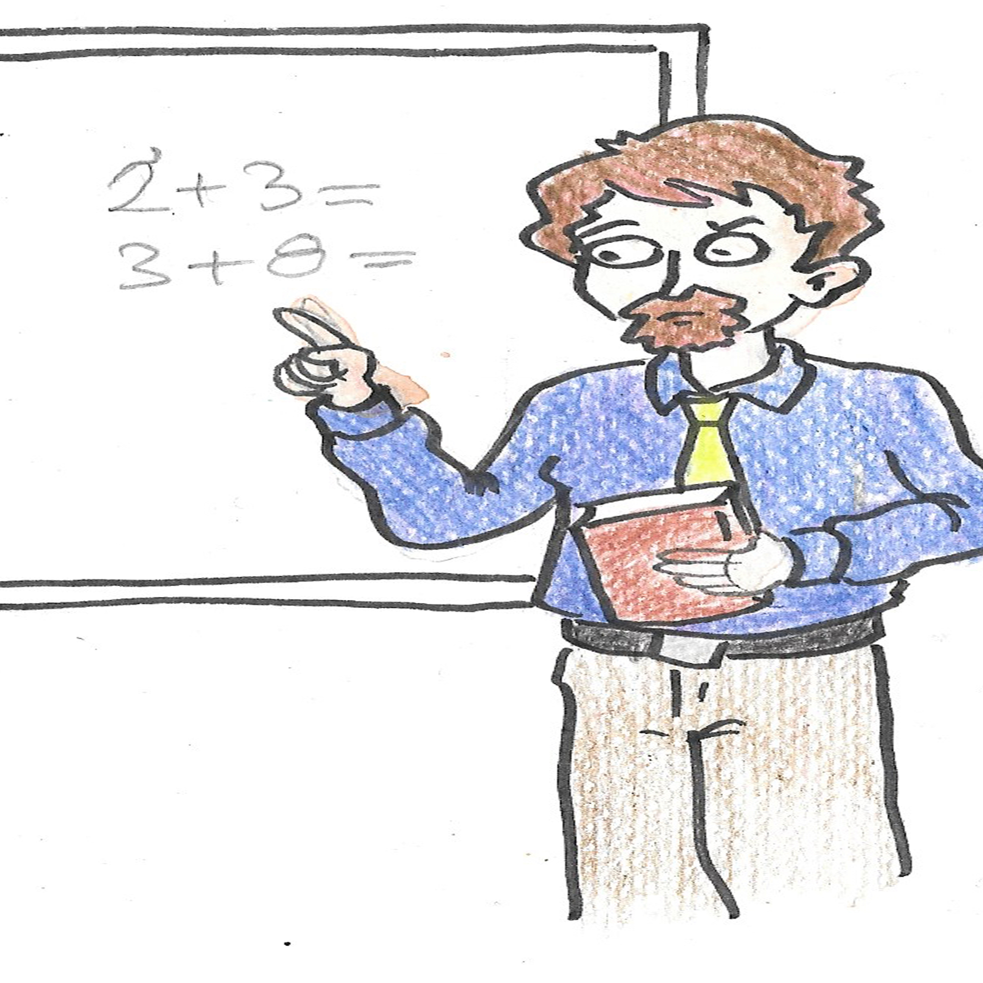
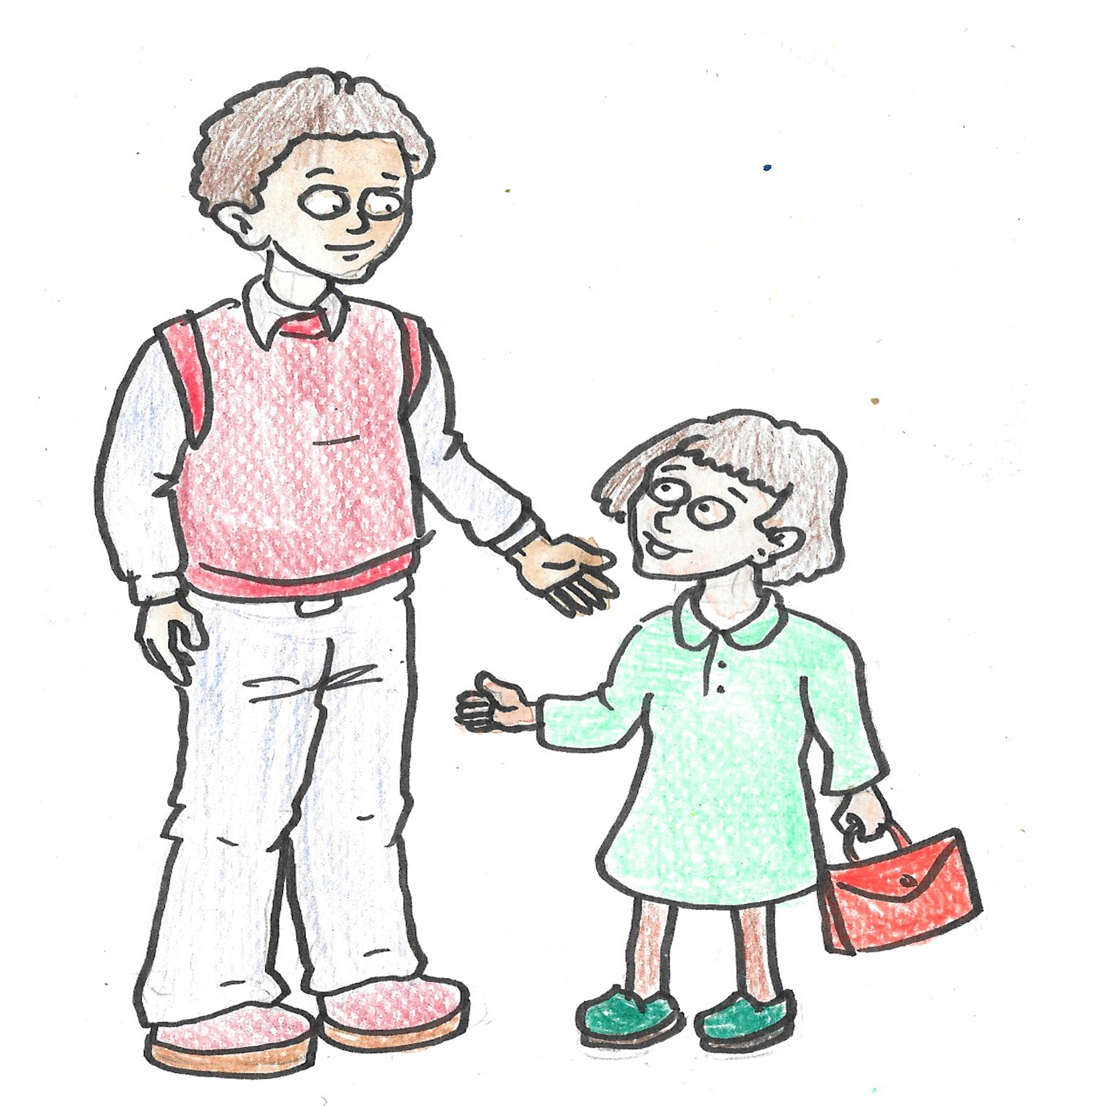
What is the role in this school of the:
Headteacher?
Cleaners?
Mealtime assistant?
Teachers?
Pupils?
Parents?
Teaching assistants?

Slide 4
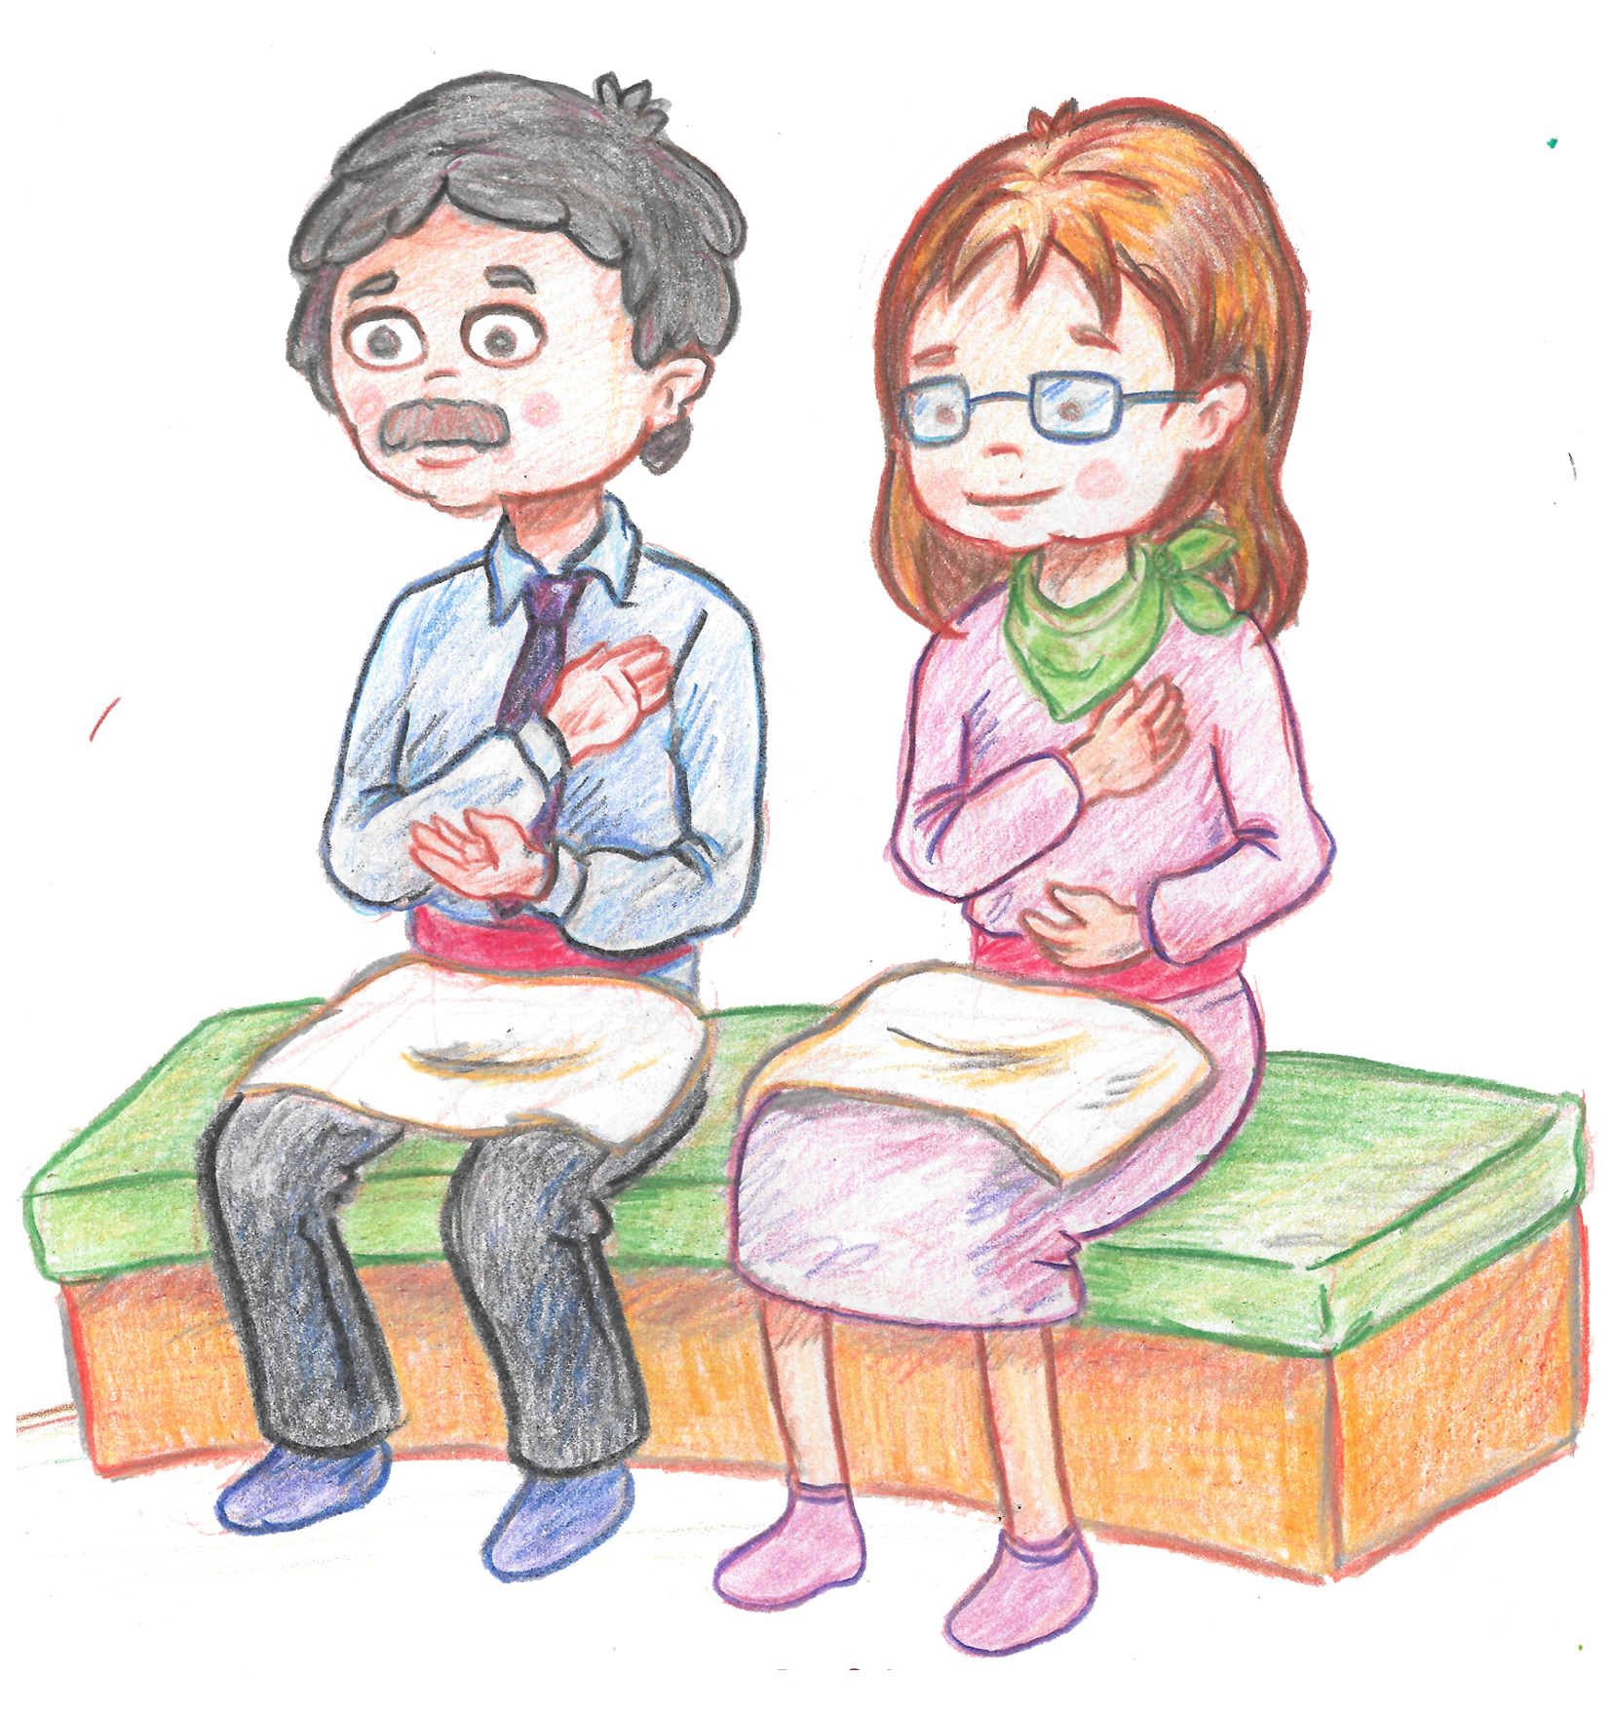
There are some clues in these pictures.
What do you think they might be?

Slide 5
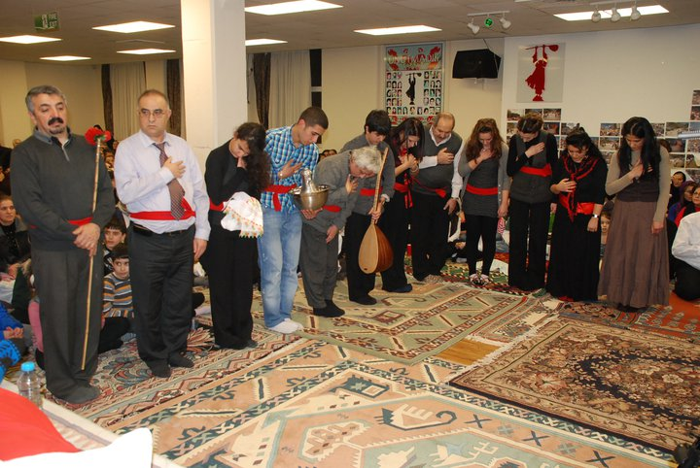
Let’s watch the video of the cem ceremony again.
https://www.youtube.com/watch?v=bKmT2FBIlnc&t=26s
Write down what each person does next to their picture on the sheet.
Which do you think is the most important service? Why?

Slide 6
Which do you think is the most important? Why? Is there more than one right answer?

