Slide 1
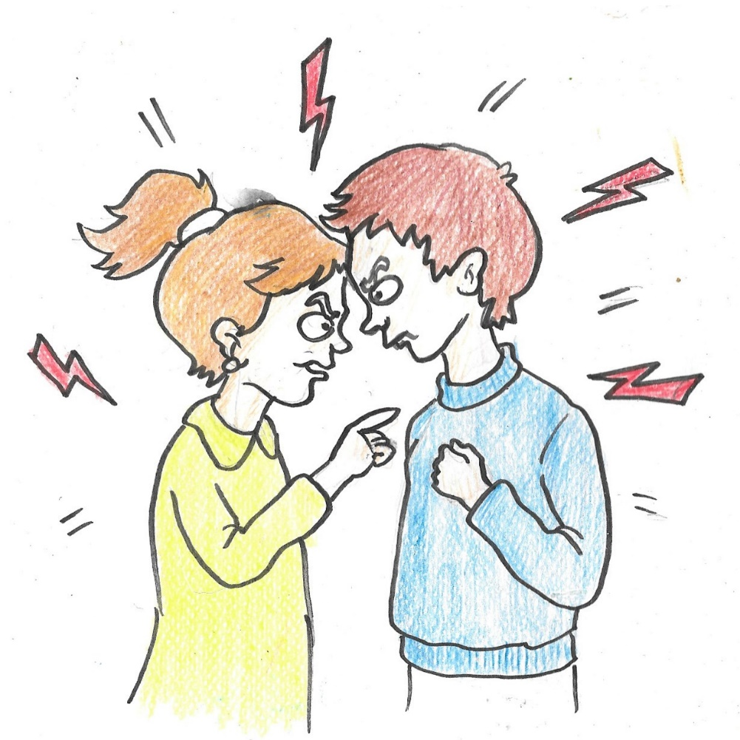
How does the cem ceremony help Alevis get on with each other?
Everyone has disagreements and arguments at times.
Think of a time at school when you have had an argument with friends.
How did it make you feel afterwards?

Slide 2
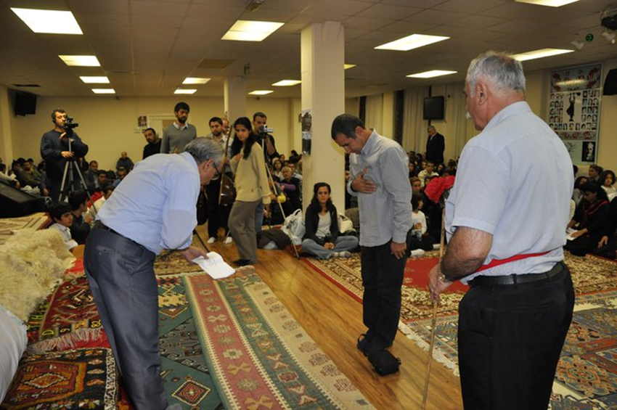
How do Alevis sort out their arguments?
Sometimes adults need help to sort out their arguments, too.
Alevis may ask for help from the Dede or Ana to solve their problems before a cem ceremony actually starts. This is called ‘conflict resolution’.
This is what is happening in this picture.
The whole group is involved!

Slide 3
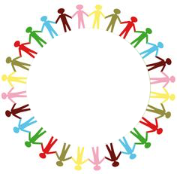
Circle time: resolving conflict
  What makes me angry?
  How does this affect my behaviour?
  What do I do to make up with a friend?
  How do I feel when we have made up?

