Slide 1
What is aşure?

Slide 2
What are celebrations?

Slide 3
The history of aşure
Noah’s ark
Mount Ararat
People cook aşure after 15 days of fasting

Slide 4
What do you see in the aşure celebration?
https://www.youtube.com/watch?v=tlKsw11rHu4

Slide 5
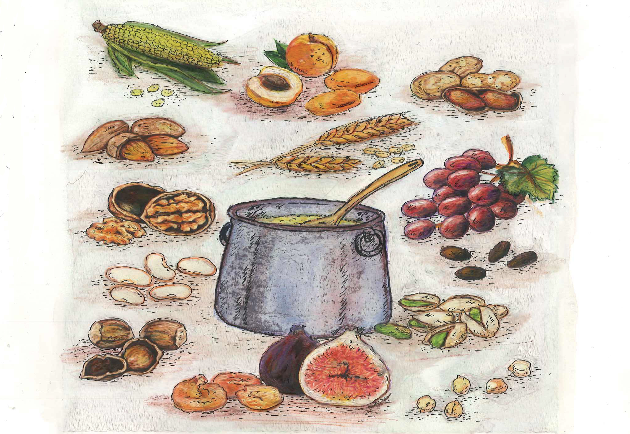
What are the ingredients of the aşure (Noah’s Ark pudding)?

Slide 6
