Slide 1
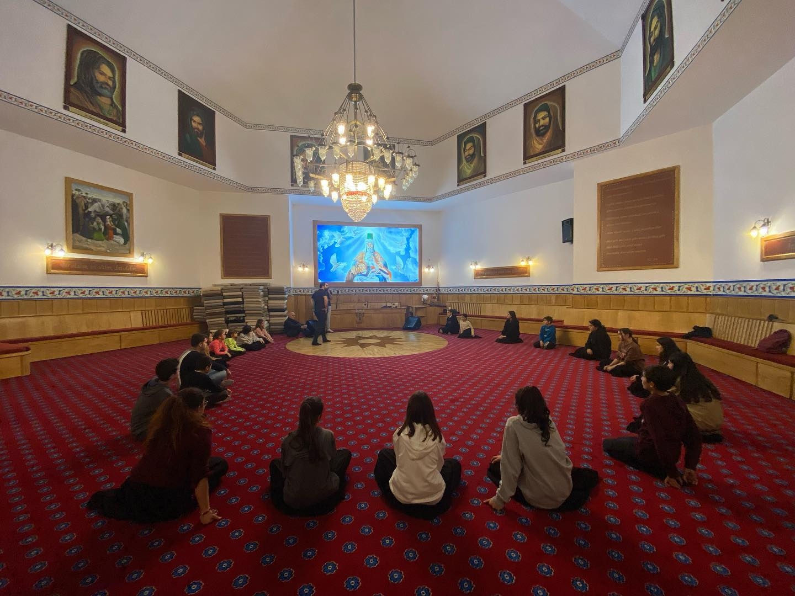
What have I learnt about Alevism?

Slide 2
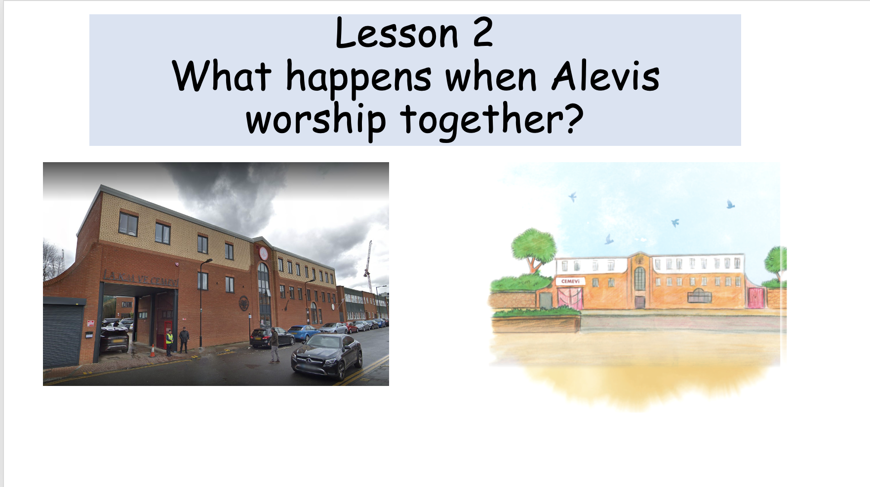
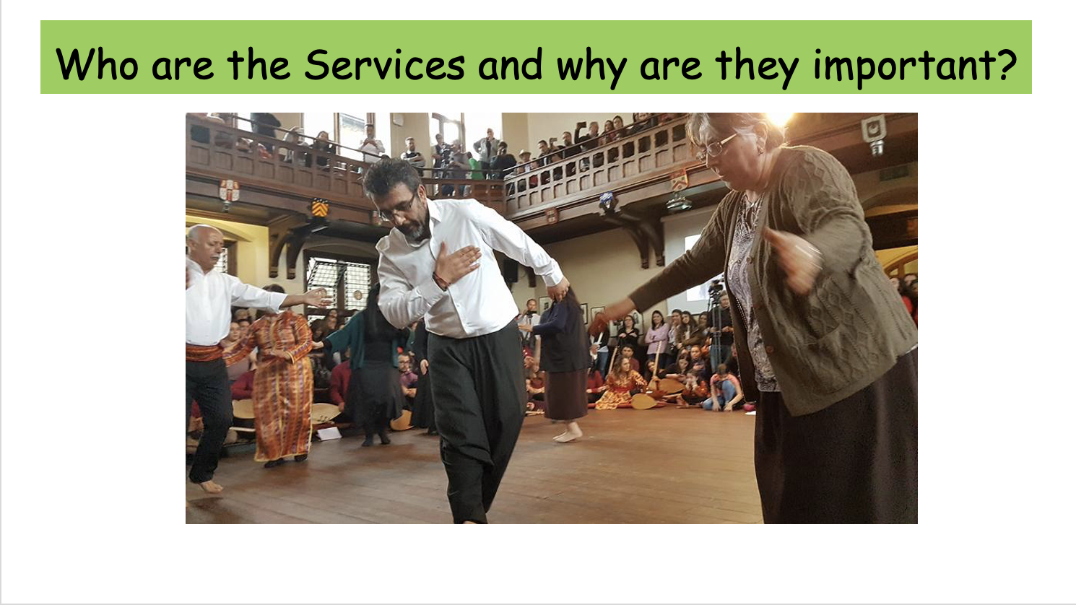
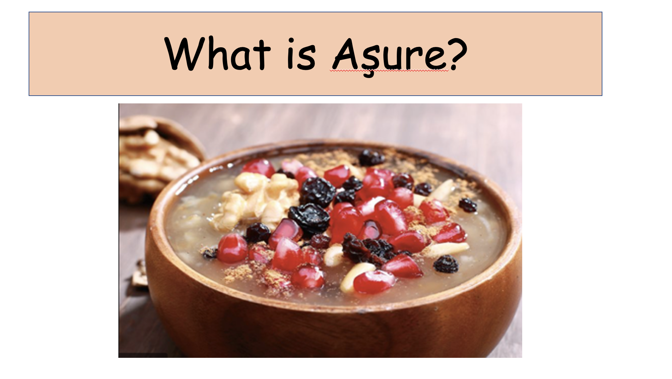
What can you remember about Alevism from these lessons?

Slide 3
Which tasks can you do?
Act out some of the roles in the cem ceremony.
Perform a semah to some Alevi music?
Write a poem to show what you feel and think about what you have learnt?
Do some art to show what you feel and think about what you have learnt?
A mixture of these?

