Slide 1
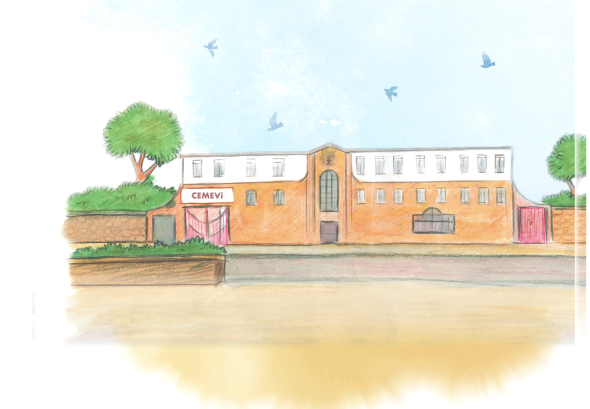
Lesson 2
What does the cemevi show about Alevi beliefs?

Slide 2
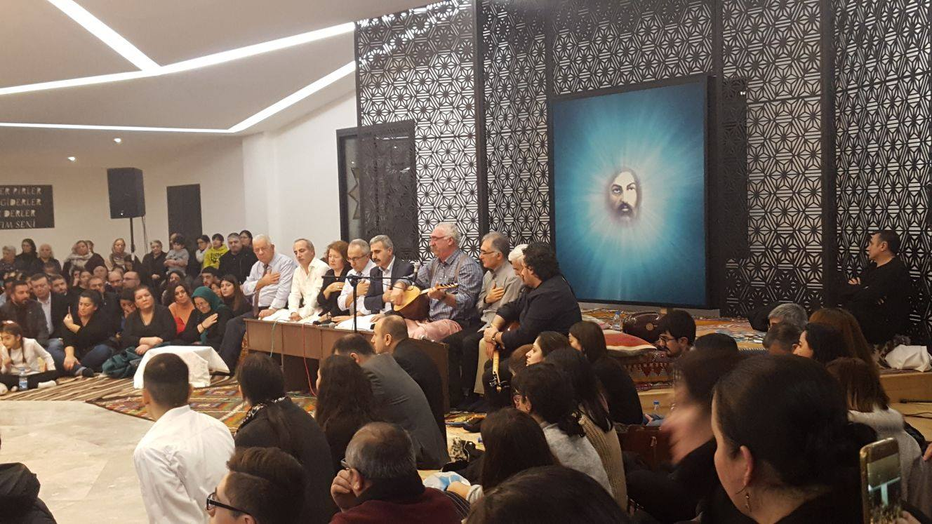
What do you notice about this picture?
The cemevi is the place for Alevis to come together and worship.
This ceremony is called cem. If possible everyone will sit in a circle facing each other.
Why do you think they will face each other?
What do you think this shows about their beliefs about people?
Cemevi in London

Slide 3
What are the main roles in the cem?
There are 12 Servers (volunteers) who have a duty to perform.
Each has a role to play in the cem.
Watch the video to learn about the servers and their roles.
https://youtu.be/PkKTpIW5hmA?si=Fe8c45mM6zLMK2qN

Slide 4
What are your roles and responsibilities?
What are your roles and responsibilities?
What do you do to help other people?
Do you have a role at home?
What is your role at school? Do you have tasks to perform?

Slide 5
Draw a picture of yourself and write about your role/responsibilities.

