Slide 1
Lesson 3
What is the meaning of Hak and the importance of serving others?

Slide 2
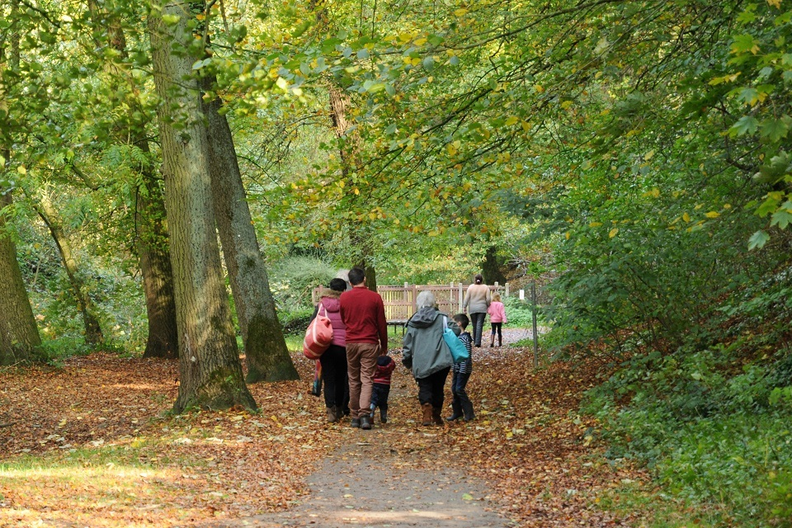
What does Hak mean?
Hak means truth.
For Alevis, we are all special or sacred because we all have Hak in ourselves.
Do you think everyone is special or sacred? Why?
If all humans are special/sacred, how should we treat each other?
Alevis believe that Hak is in nature too.

Slide 3
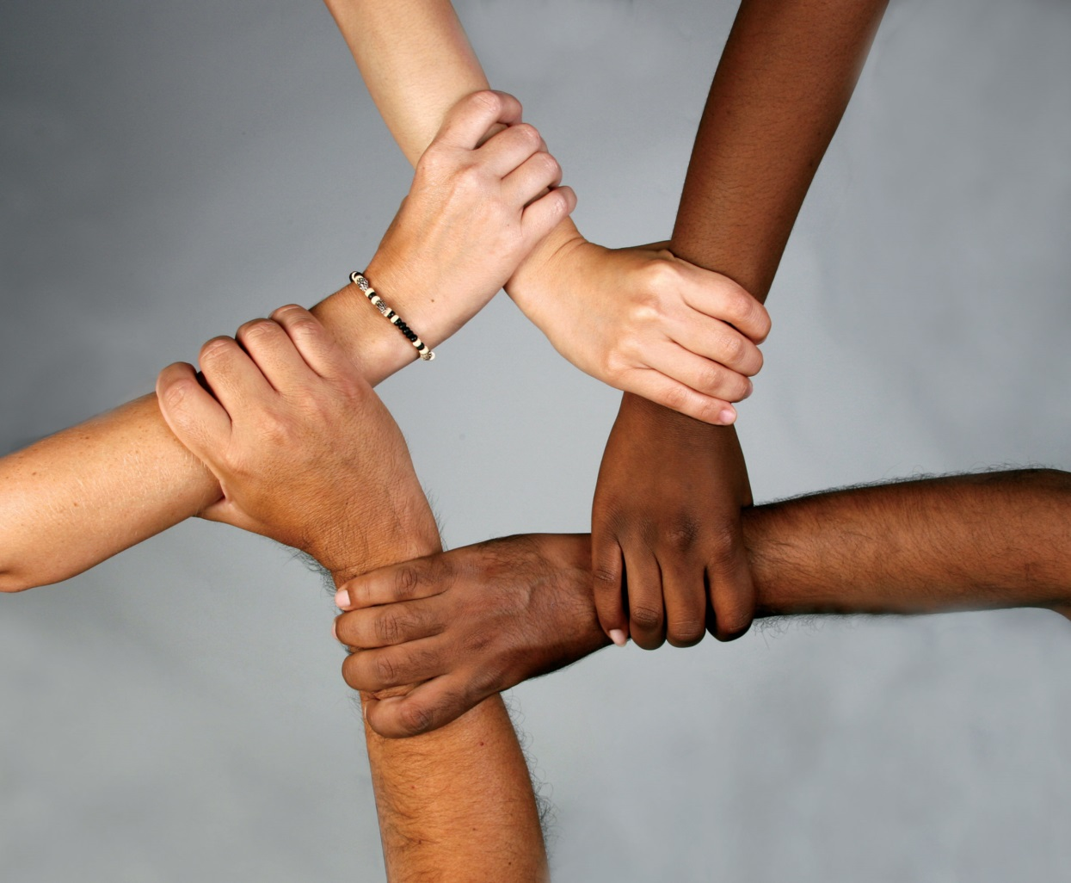
What does ‘we are all equal’ mean?
Therefore, we should treat each other with respect.

Slide 4
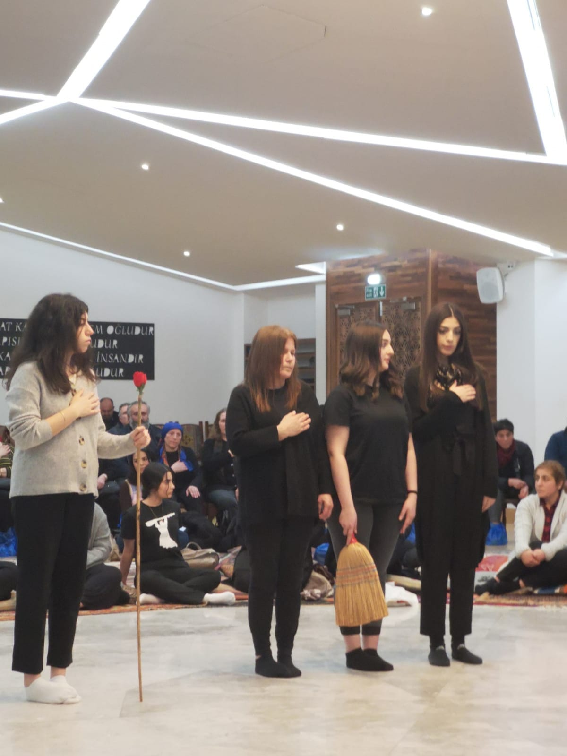
What do you see in this picture?
In the cem ceremony this is shown in many ways.
Notes:
.

Slide 5
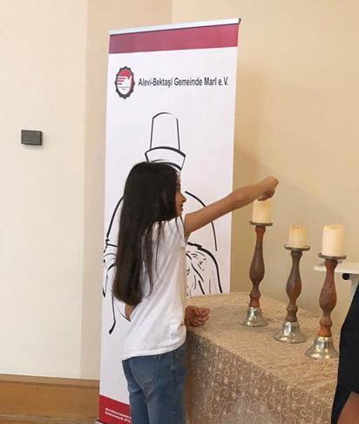
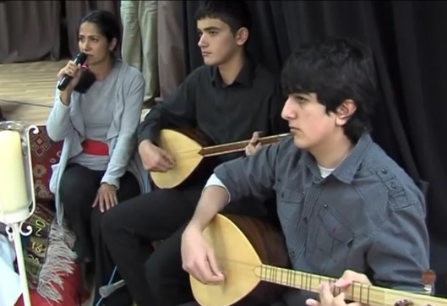
What do you see in these pictures?

Slide 6
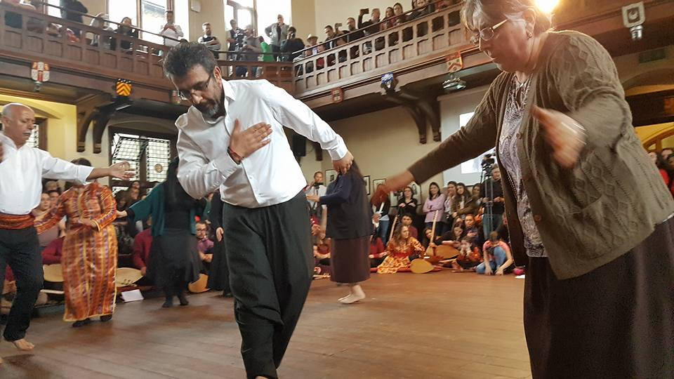
What do you think is happening in this picture?

Slide 7
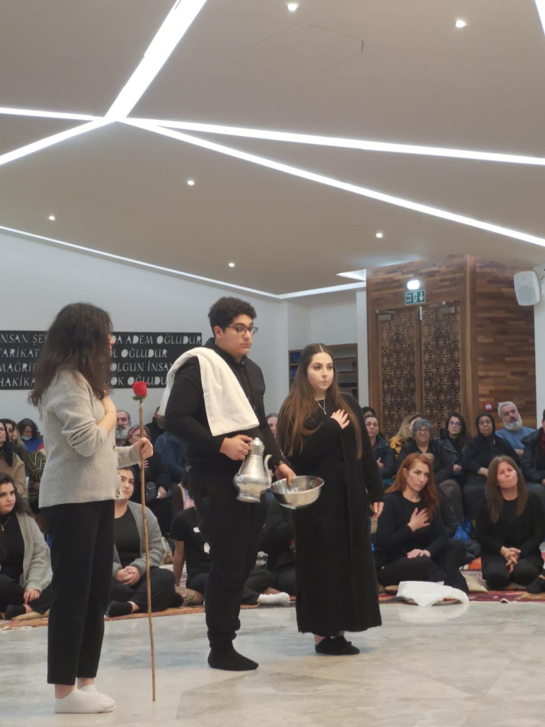
Why do Alevis go to a cemevi?
Feelings?
Beliefs?
Actions?
Sharing with others?

Slide 8
What have you learnt about Alevism and the cemevi?
What have you found most interesting in your learning about Alevism?
What do you think is the most important belief in Alevism? Why?
What do you think is the most important practice in Alevism? Why?
How would you explain Alevism to someone who doesn’t know about it in no more that three sentences?

