Slide 1
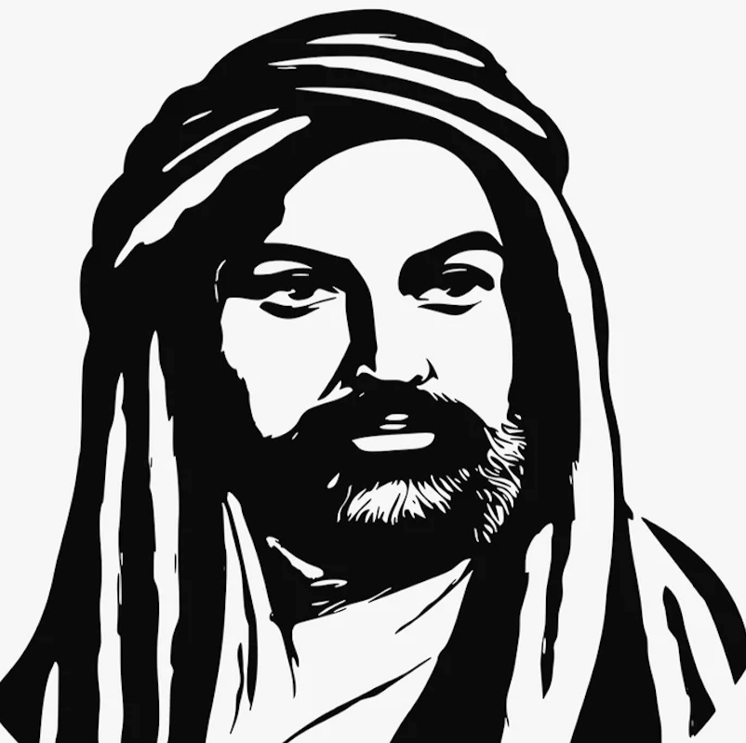
Lesson 1
Who is Ali?

Slide 2
Are there any rules that Alevis need to follow?
What is their god called?
Do they have a place of worship?
Do men and women worship together?
Do they have any special food?
Do they wear special clothes?
Do they have a special symbol?
What languages do they speak?
Do they sing or dance during their worship?
Is light important in Alevism?
How important is community to Alevis?
What do you remember/know about Alevism?

Slide 3
Which people are important to you?

Slide 4
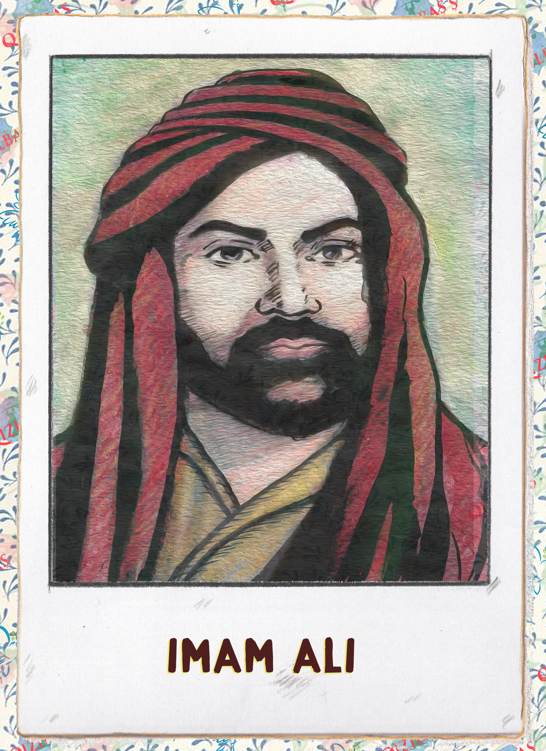
Ali’s life
He was born in March 599 CE and was killed in 661 CE (62 years old)
He was married to Fatma and father of Hasan, Hüseyin and Zeynep
He led the Cem of Forties, the first Cem known to have taken place.
Ali died and came back to life

Slide 5
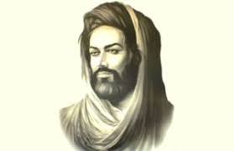
Who is Ali?
Alevis believe Ali is the most important figure in Alevism. Ali is one with Hak and on the side of the oppressed Ali represents the ideal human What qualities would the ideal human need?

Slide 6
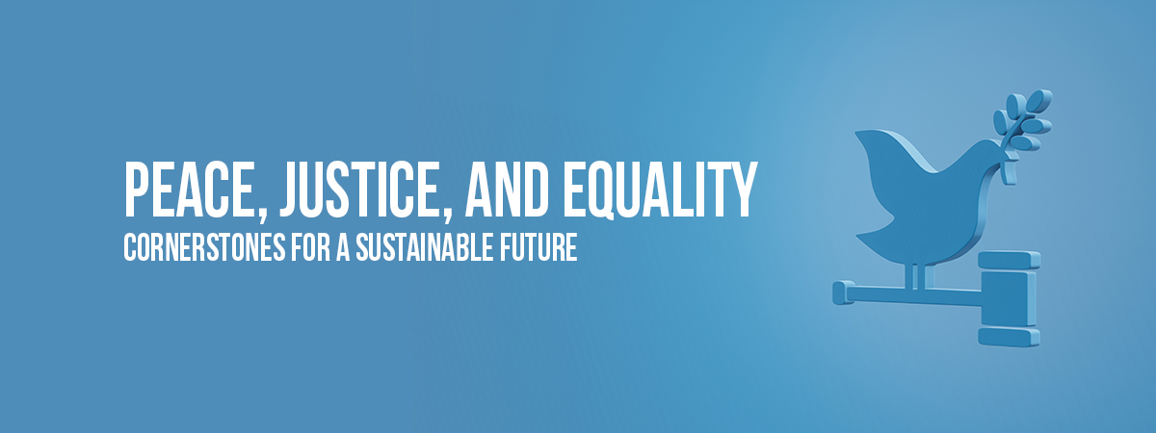
What are the key values of Ali?
These are the key values Ali stood for:
  Justice
  Peace
  Equality
Can you link the examples with the values
1. Ali wanted to abolish slavery.
2. Ali wanted to abolish men having more than one wife at a time.
3. Ali wanted to end wars.
4. Ali wanted fair pay for servants

