Slide 1
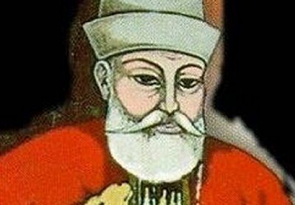
Lesson 2
How did Hacı Bektaş influence Alevism?

Slide 2
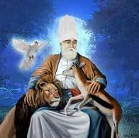
Who is Hacı Bektaş?
One of the most important figures in Alevism (1209-1271)
He said: “It is not enough to seek truth; we must also live truthfully.”
What do you think this means?

Slide 3
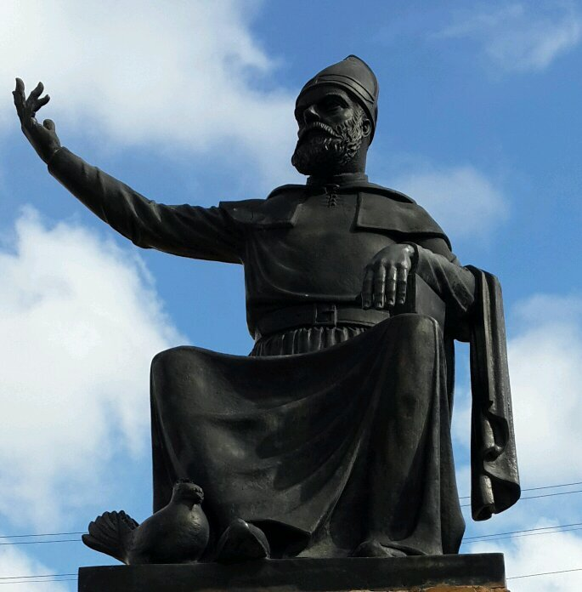
What does this statement from Hacı Bektaş mean?
“Any road that doesn't follow science, ends in darkness” (Haci Bektas Veli)

Slide 4
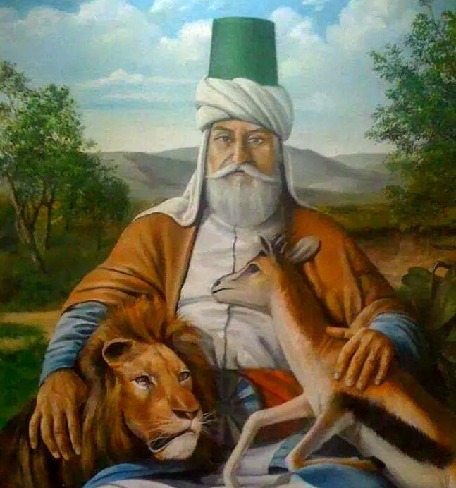
What do you see in this picture?
He taught that Hak is in everything.
He is pictured with a gazelle and a lion because he said:
‘Greed and malice disappear by love in our midst. The lion and gazelle are friends in our embrace.’
Once we accept that Hak is in everything we cease being violent. It shows true humanity.

Slide 5

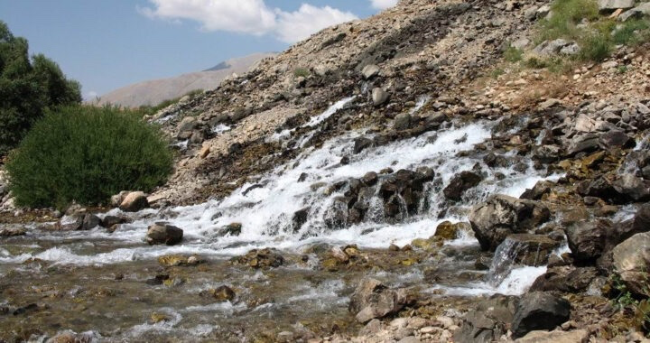
What is most important in life?
1
2
2
3
3
3
4
4
environment
5

Slide 6
What do you think these statements mean?
“Whatever you are searching for, search in yourself
Not in Jerusalem, not in Makkah.”
“My Ka’aba (temple) is the human being.”
How might they influence Alevi people?
What difference might it make if everyone held these beliefs?
Do you agree with them?
Why?/Why not?

