Slide 1
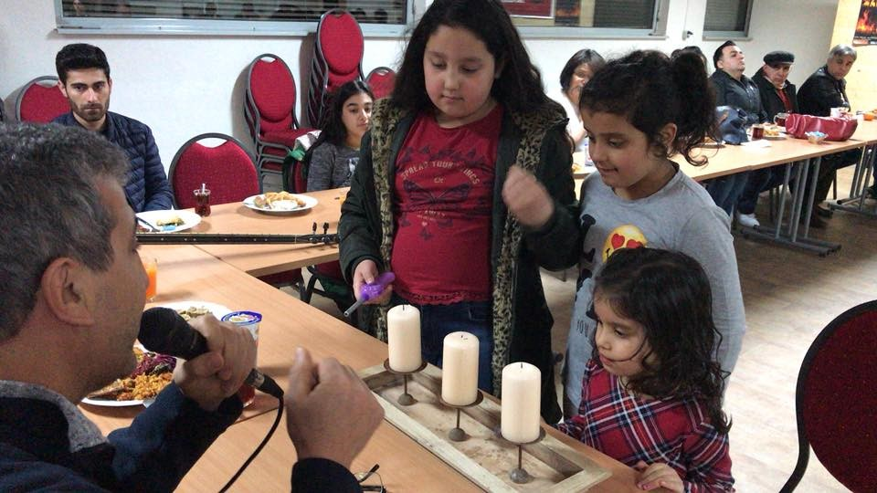
Lesson 3
What are the most important teachings about life for Alevis?

Slide 2
What do you remember about Alevi beliefs?
Why is Ali important?
What is Hak?
Why is Hak is important?

Slide 3
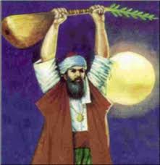

Who is Pir Sultan?
One of the most famous saints, poets and musicians (1480-1550)
His hymns are used a lot in the Cem ceremony. They are very symbolic and use a lot of metaphor and imagery.
His poems carry deep meaning that helps Alevis think about the meaning of life.

Slide 4
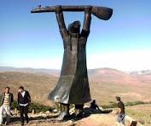
What do you think Pir Sultan means in this poem?
Extracts from one of his poems
  “If you want to enter the cem of the wise
  Rid yourself of hatred and arrogance.”
  “Why do you need to see the imperfection of others
  Look in your own mirror and then come.”

Slide 5

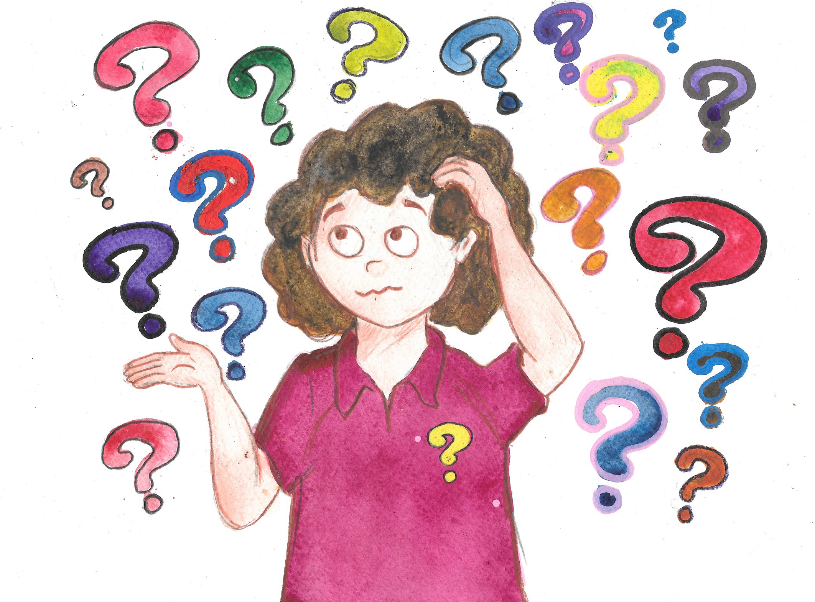
What do you think is the meaning or purpose of life?

Slide 6
Write your answers to the following questions
What qualities do they have that you admire?
How do they influence you?
Can you think of famous people who are a bad influence on others?
What makes someone a good or a bad role model?
Why are role models important?

